Slide 1
F/V BAY RUNNER
Off-Season Operations and Maintenance Plan
December to March | Annapolis City Marina, Slip 47 | Owner-operator John W. Singleton
The season is for fishing. The off-season is for getting the boat right.

Slide 2
Four Months, Four Jobs
December
January
February
March
Haul-out at Marshwood Partners. Bottom wash, zincs, paint, condition survey MW-2025-0418.
Both Cummins QSB 6.7 diesels serviced. Hydraulic puller seal and hose rebuild in the shed.
Nine hundred registered pots rebuilt in strings. Safety gear checked, EPIRB battery replaced.
Relaunch, electronics and radar test, sea trial with Tommy before the first string goes over.
Big items paced across three months so the cash and the back both hold. Totals roll up in the maintenance workbook.

Slide 3
Where the Off-Season Money Goes
By the Numbers
Engine hours at haul
4,820 hrs
Yard invoice, December
$1,321
Pots rebuilt in strings
900
Heaviest mesh work
String E
EPIRB battery
Replaced
Total off-season spend
$2,956

Slide 4
System Checklist Before April 1
System | Task | Vendor | Target
Twin Cummins diesels | Oil, filters, coolant, belts | Self, marina shed | January
Hydraulic puller | Seal and hose rebuild, load test | Self, marina shed | January
Hull and running gear | Bottom paint, zincs, prop dress | Marshwood Partners | December
Safety gear | Flares, PFDs, EPIRB, extinguishers | West Marine | February
Electronics | Chartplotter and radar power test | Self | March
Pots, strings A to F | Mesh, cull rings, escape panels | Self, Tommy | February

Slide 5
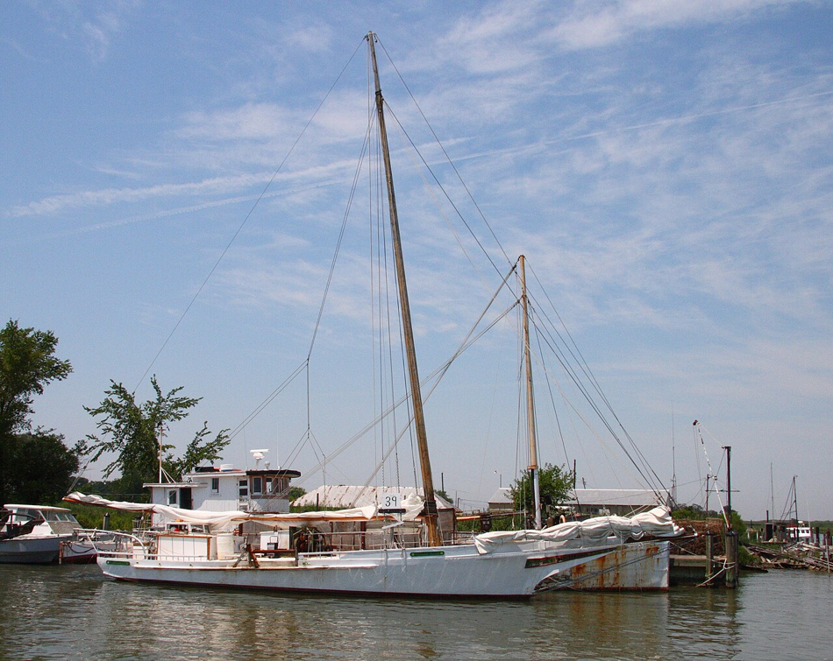
The Whole Argument
A real haul-out in January beats a cracked hose off Tolly Point in June with a charter aboard.
The reward for a good winter of work is a spring where the boat just runs, and I can keep my head on the crabs and the weather instead of the bilge.
By April 1 we are dropping pots, not fixing problems.

